Slide 1
Introduction to Probability
Set Theory & Venn Diagram

Slide 2
Set Theory & Venn Diagram
Sets and Elements
Equivalent Sets
Subsets
Proper Subsets
Empty Sets
Set Notation
Set Builder Notation
Set Conclusion
Intersection of Sets
Union of Sets
Disjoint Set
Universal Set
Compliment of a Set
Venn Diagram Region Map

Slide 3


What is a Set ?
In Layman terms:
Set is a collection of things which are grouped together based on some
criteria that makes them similar.
The easiest way to think about a “SET” are things in everyday life:

Slide 4
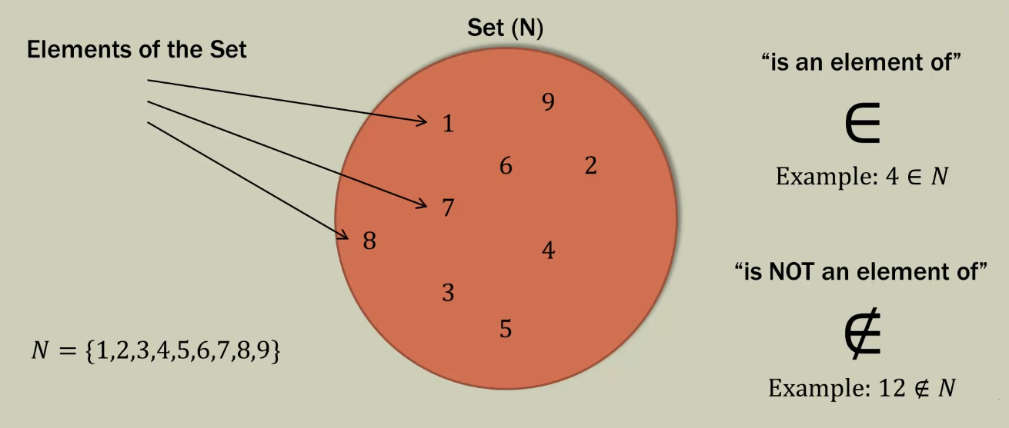
Sets and Elements

Slide 5
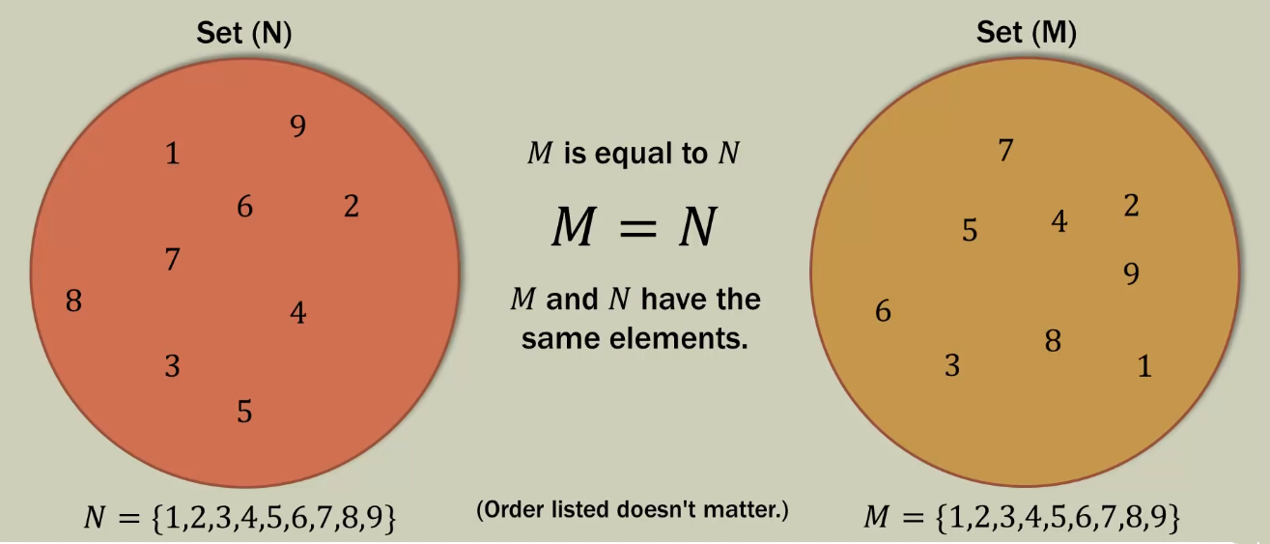
Equivalent Sets

Slide 6
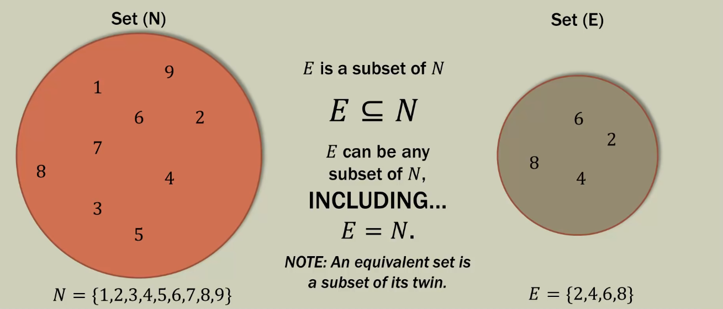
Subsets

Slide 7
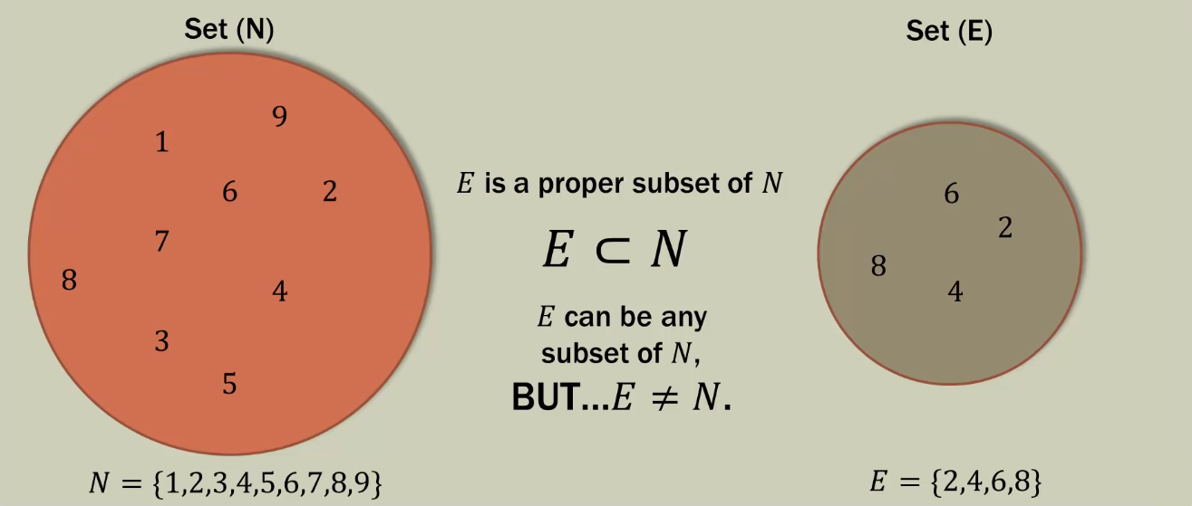
Proper Subsets

Slide 8
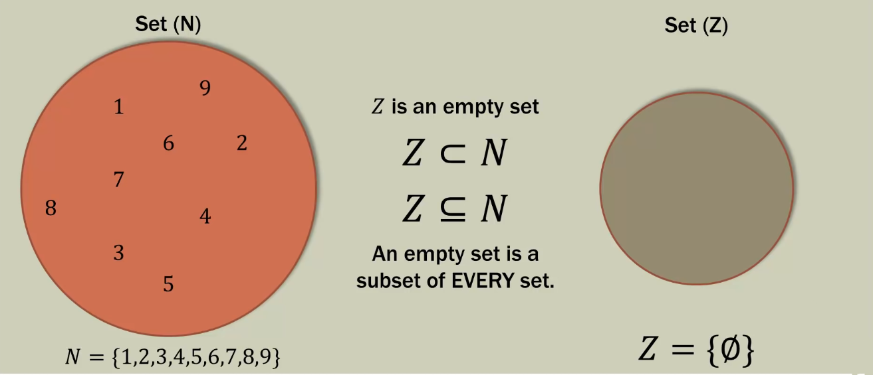
Empty Set

Slide 9
Subsets Vs. Proper Subsets
S = {1,2,3}
Set | Subset | Proper Subset
{Ø} or {}
{0}
{1}
{2}
{3}
{0,1}
{0,2}
{1,2}
{0,1,2}

Slide 10
Set Notation
We often use set notation to represent a list of outcomes
Example: Single Coin Flip
S = { H,T }
Example: Single Die Roll
S = { 1,2,3,4,5,6 }
Example: Rain in a day
S = { Rain, No-Rain, Rain }
Example: Flip Two Indistinguishable Coins
S = { (H,H), (H,T), (T,T) }
Example: Flip Two Distinguishable Coins
S = { (H1,H2), (H1,T2), (H2,T1), (T1,T2) }

Slide 11

Set Builder Notation
Set Builder Notation is a way of writing out what we want in our set
C = { n | n is an odd integer less than 10 }
C = { n | n is an odd integer < 10 }
Set Notation: C = {1,3,5,7,9}
D = { n | n is one of the seven days }
Set Notation: P = {Mon, Tue, Wed, Thu, Fri, Sat, Sun}

Slide 12
Set Conclusions
Set is a simple way of categorizing things based on some common criterion.
We do this all the time. Usually we group things together
e.g. clustering clothes together, gadgets together etc.
Real-life examples:
Amazon offers “similar items” based on the set concept.
Google offers “similar apps” in its app store.

Slide 13
Set Operations

Slide 14
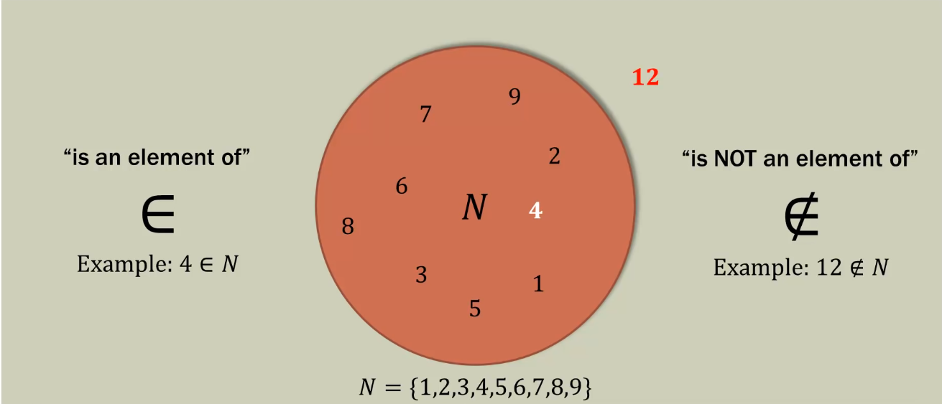
Set and Elements

Slide 15
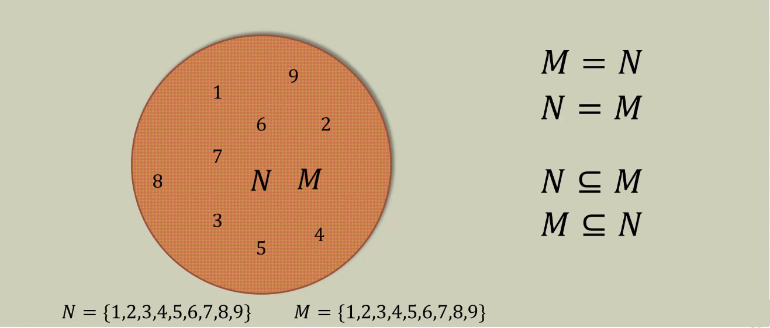
Equivalent Sets

Slide 16
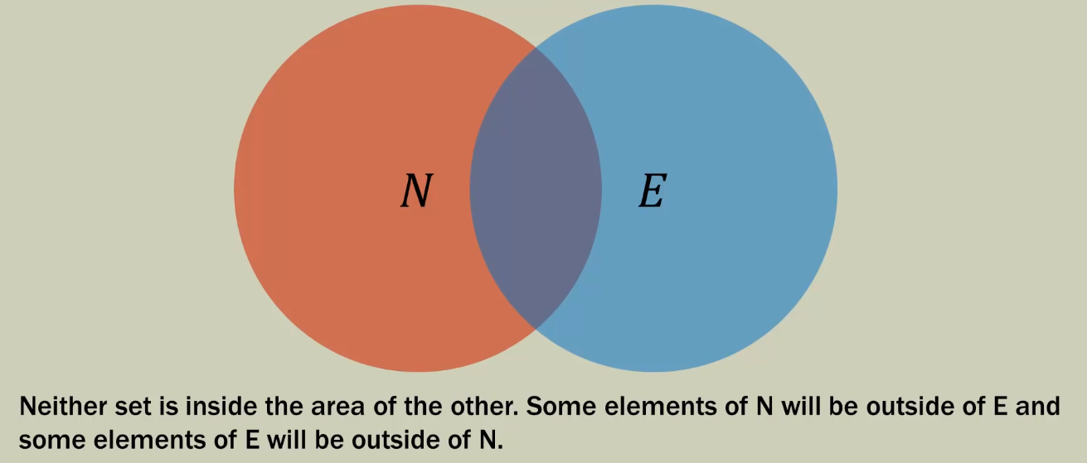
Set Operations: Intersection

Slide 17
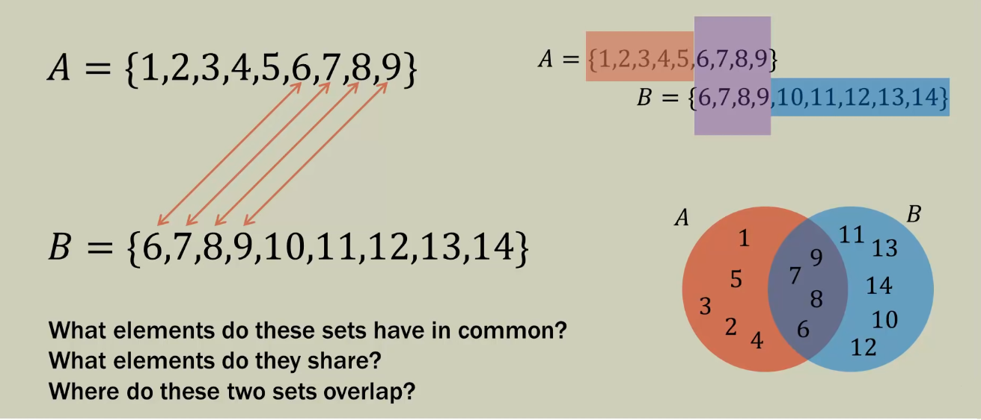
Set Operations: Intersection

Slide 18
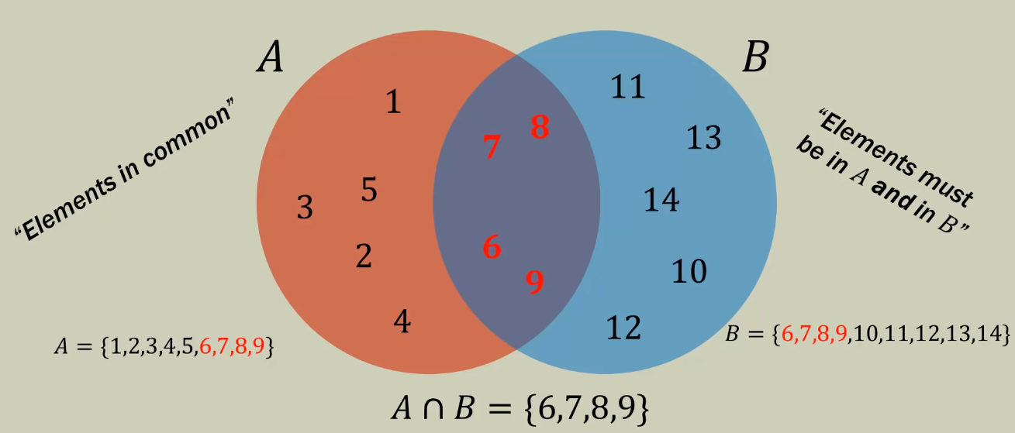
Set Operations: Intersection

Slide 19
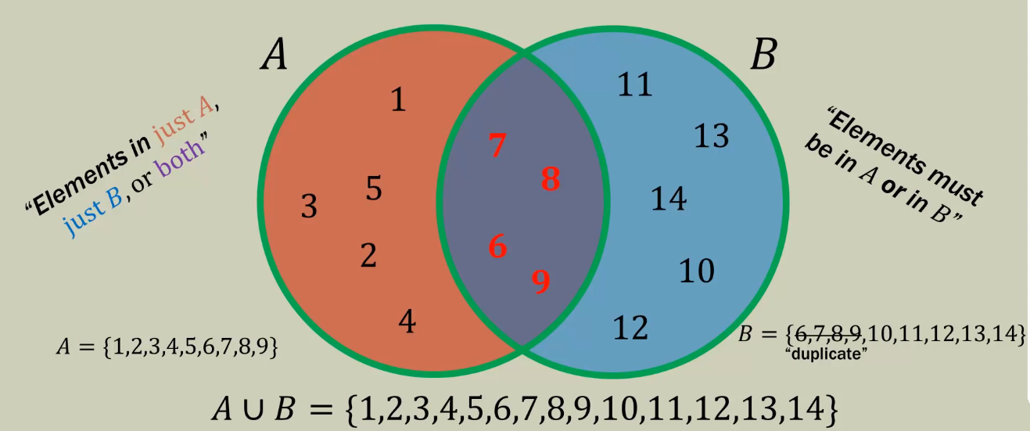
Set Operations: Union

Slide 20
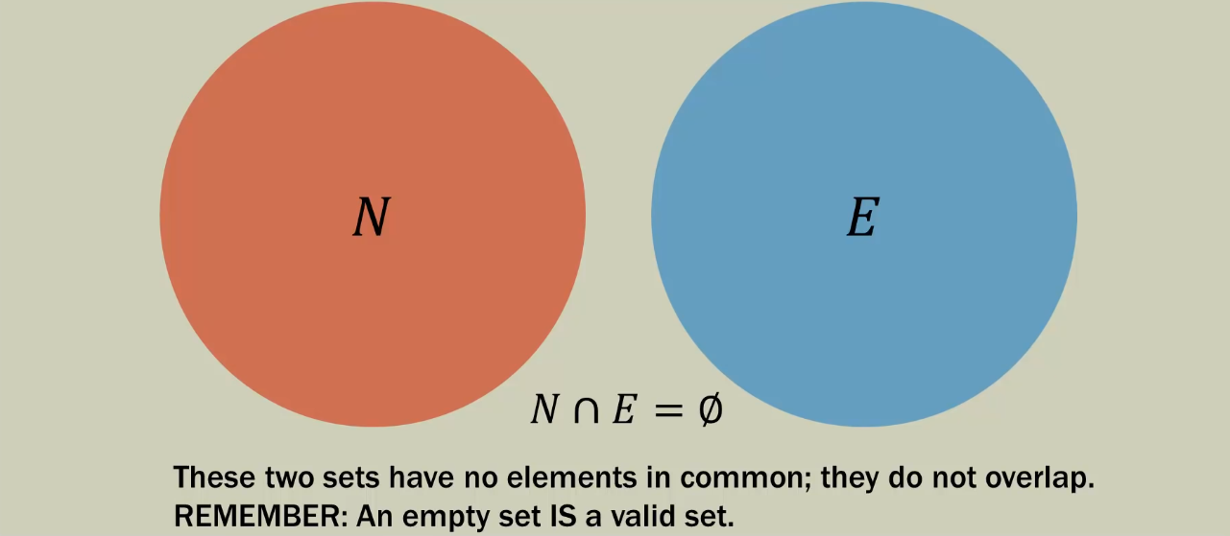
Disjoint Set

Slide 21
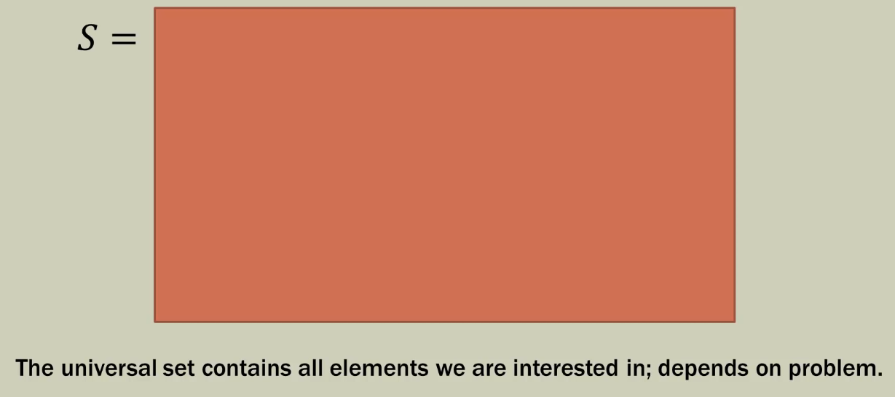
Universal Set

Slide 22
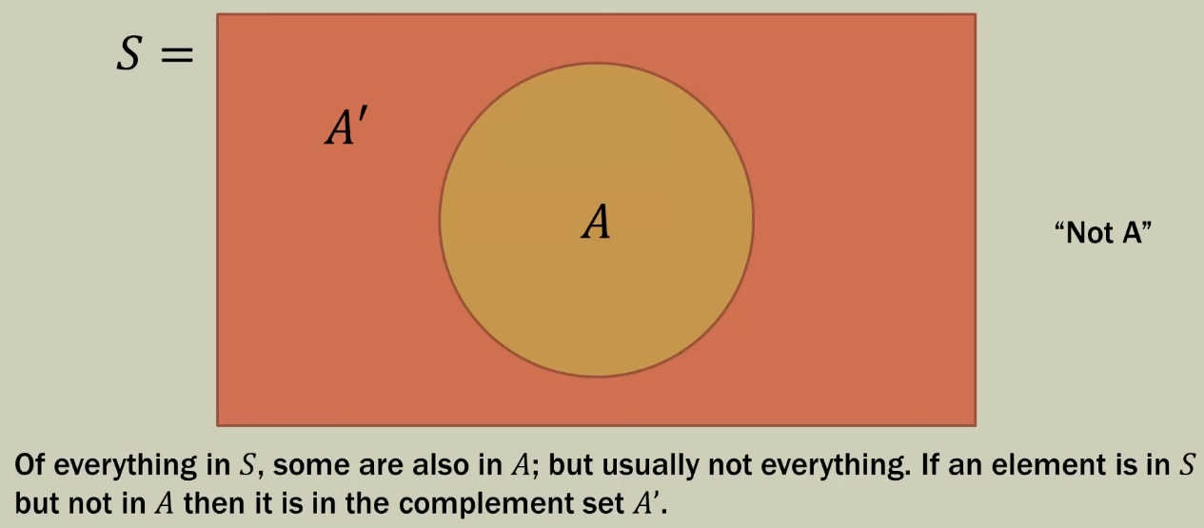
Compliment of a Set

Slide 23
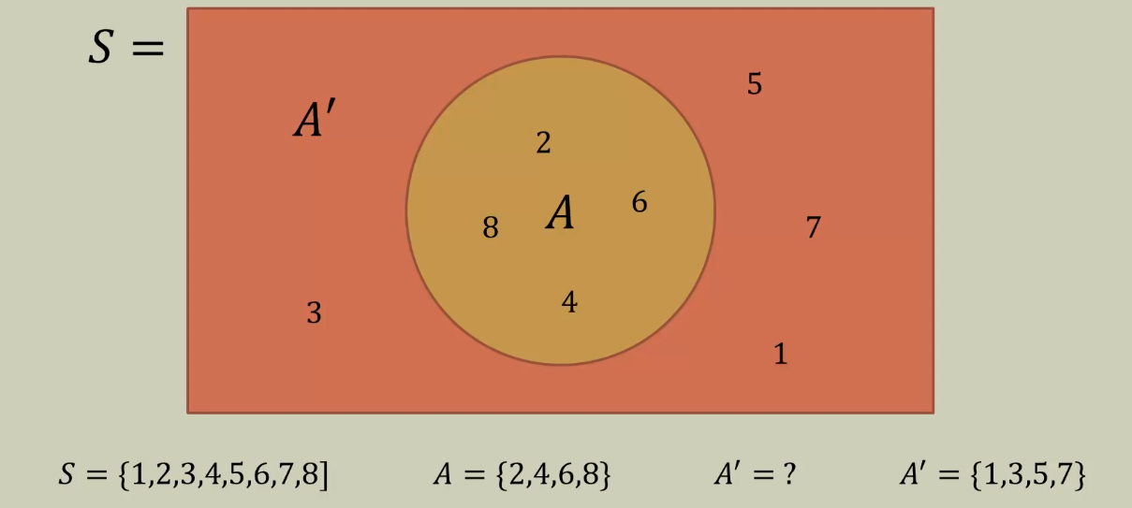
Compliment of a Set

Slide 24
Venn Diagram Region Map

Slide 25
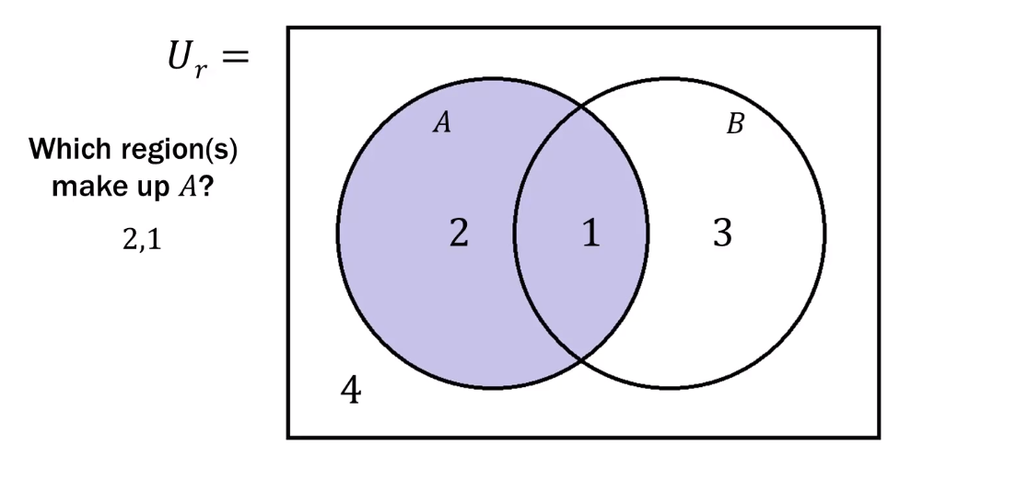
Venn Diagram Region “Map”

Slide 26
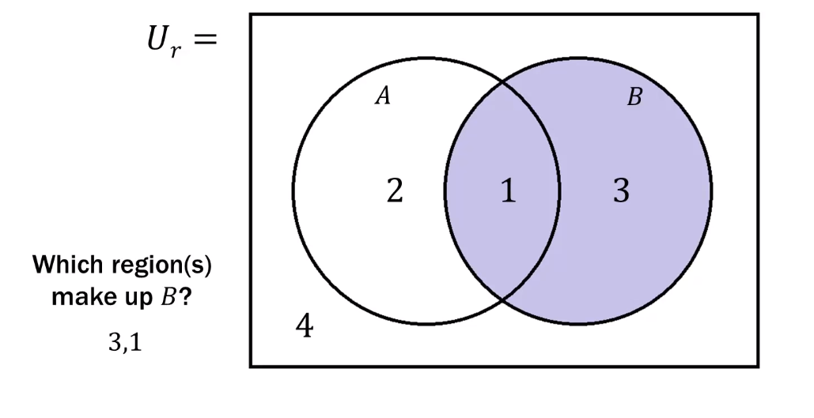
Venn Diagram Region “Map”

Slide 27
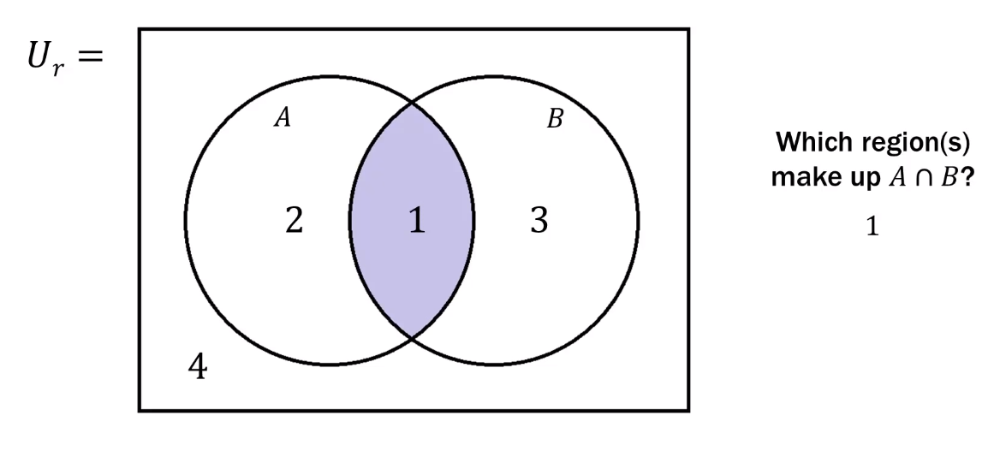
Venn Diagram Region “Map”

Slide 28
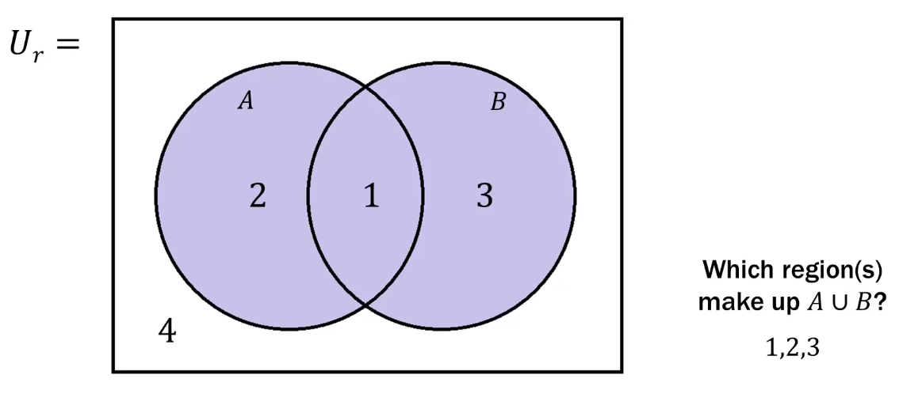
Venn Diagram Region “Map”

Slide 29
Exercise

Slide 30
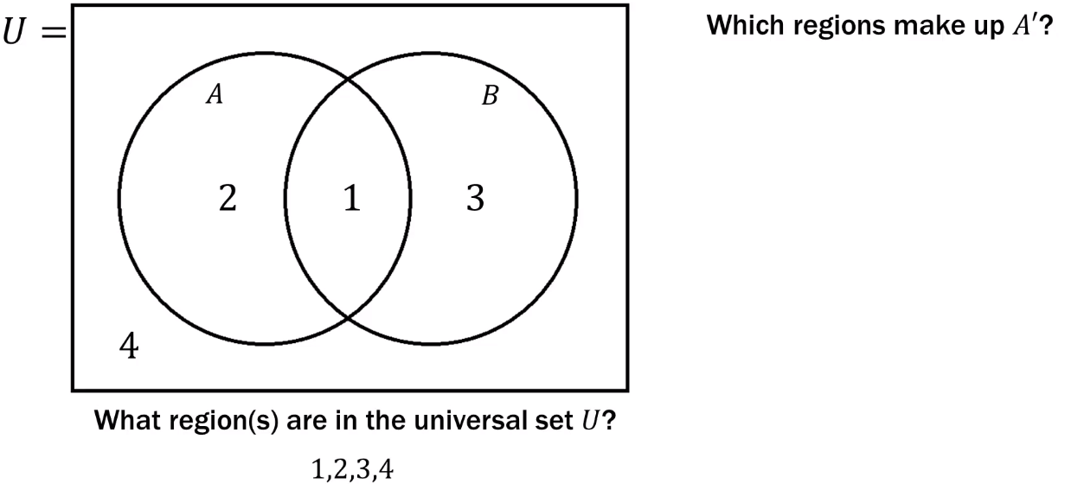
Venn Diagram Region “Map”
Question

Slide 31
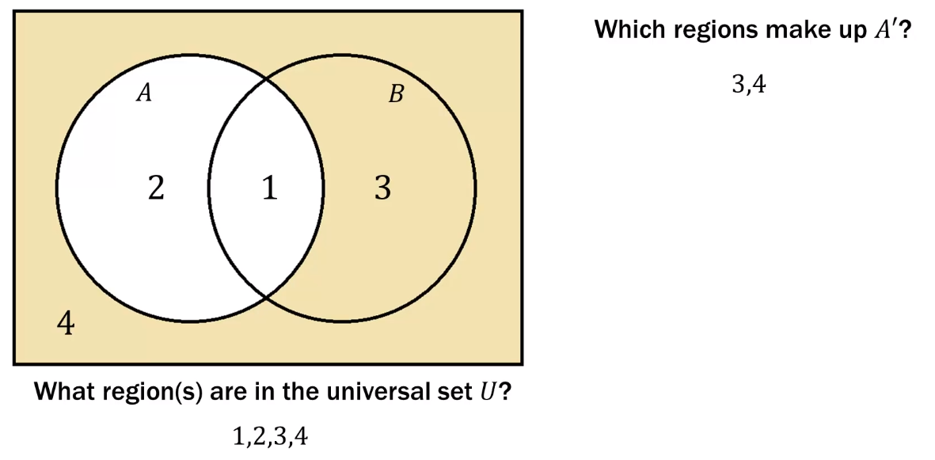
Venn Diagram Region “Map”
Solution:

Slide 32
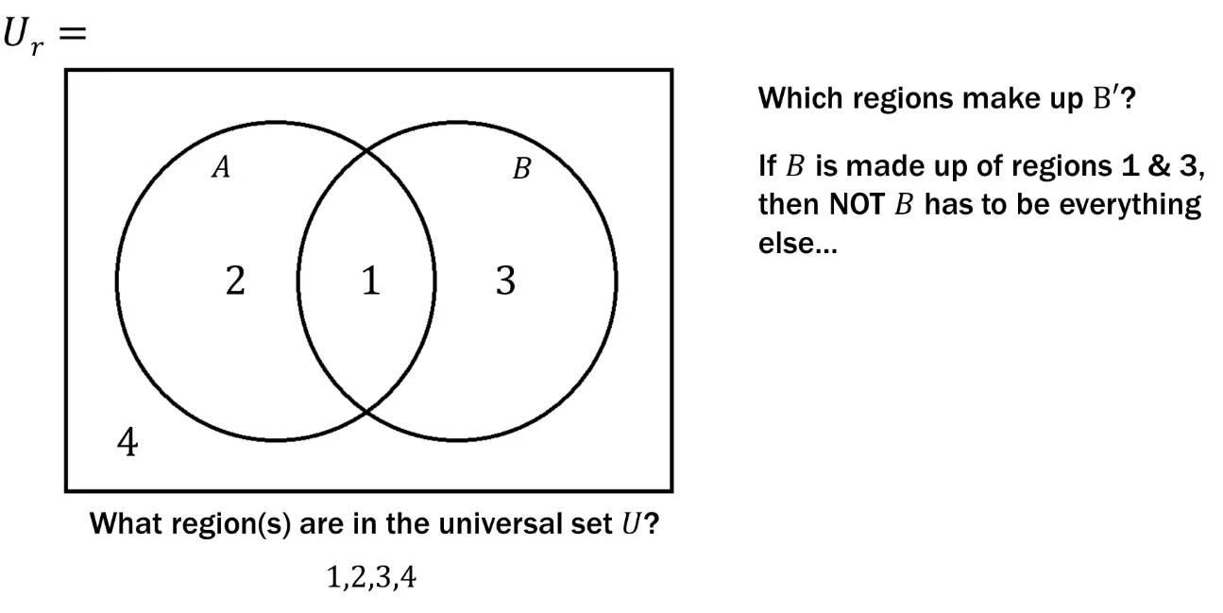
Venn Diagram Region “Map”
Question:

Slide 33
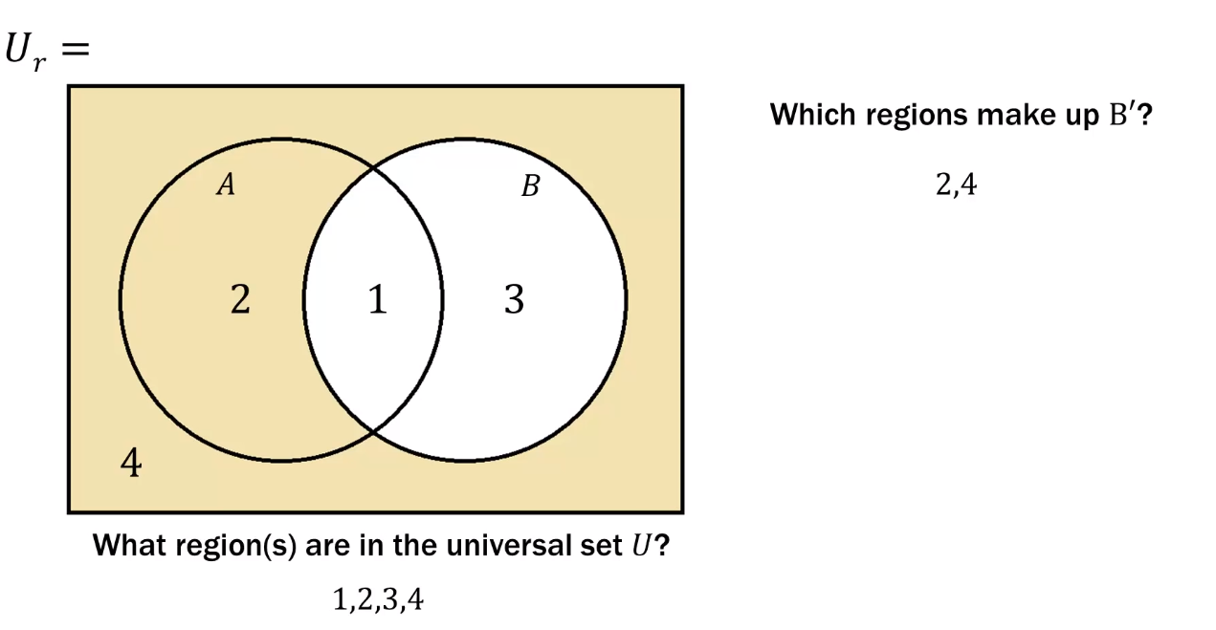
Venn Diagram Region “Map”
Solution:

Slide 34
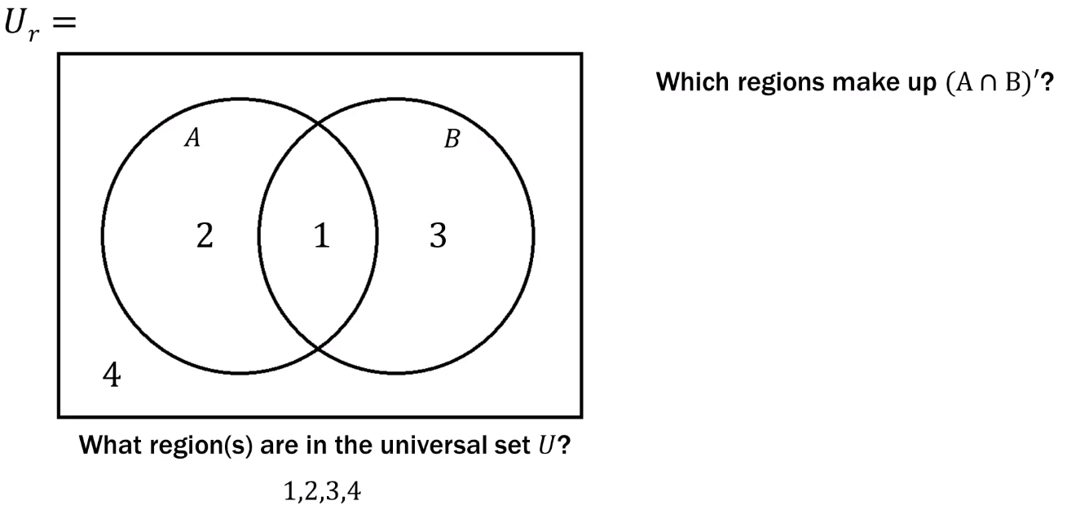
Venn Diagram Region “Map”
Question:

Slide 35
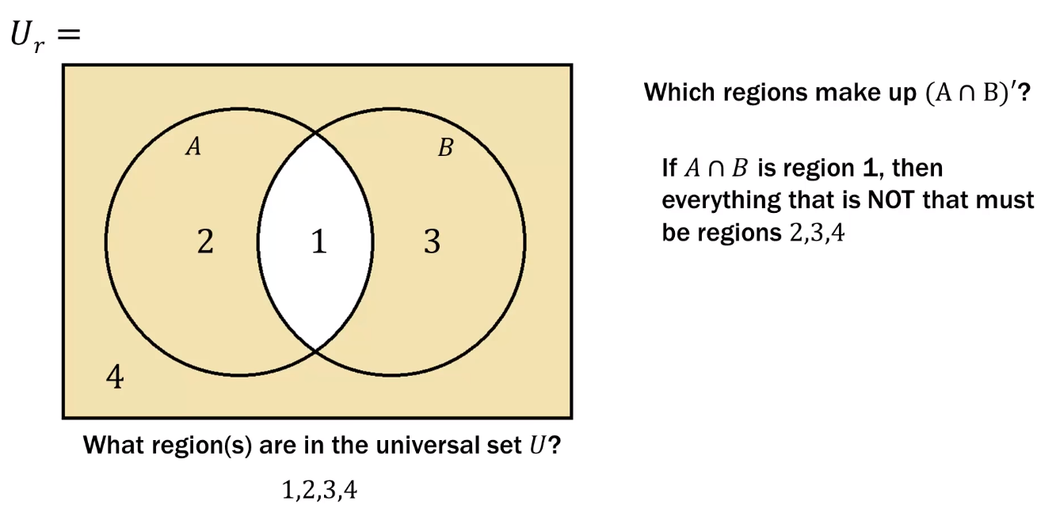
Venn Diagram Region “Map”
Solution:

Slide 36
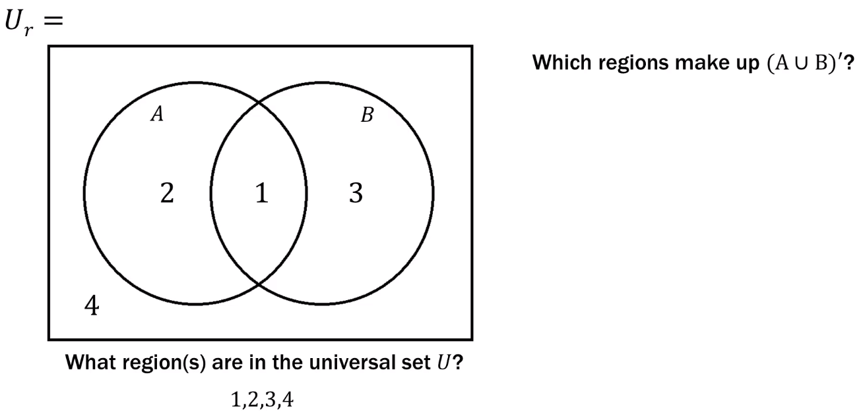
Venn Diagram Region “Map”
Question:

Slide 37
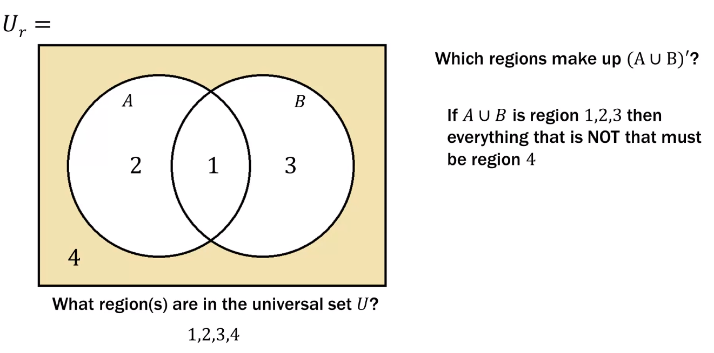
Venn Diagram Region “Map”
Solution:

Slide 38

Venn Diagram Region “Map”
Question:

Slide 39
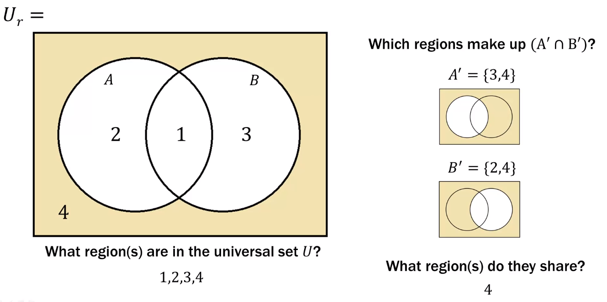
Venn Diagram Region “Map”
Solution:

Slide 40
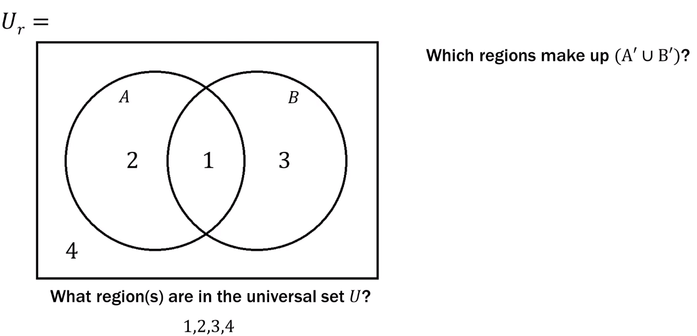
Venn Diagram Region “Map”
Question:

Slide 41
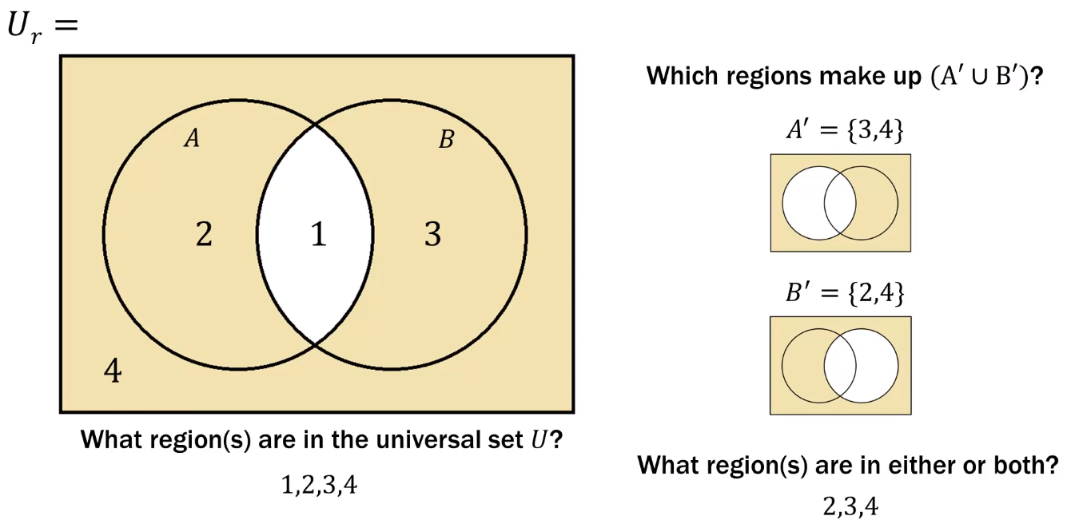
Venn Diagram Region “Map”
Solution:

Slide 42
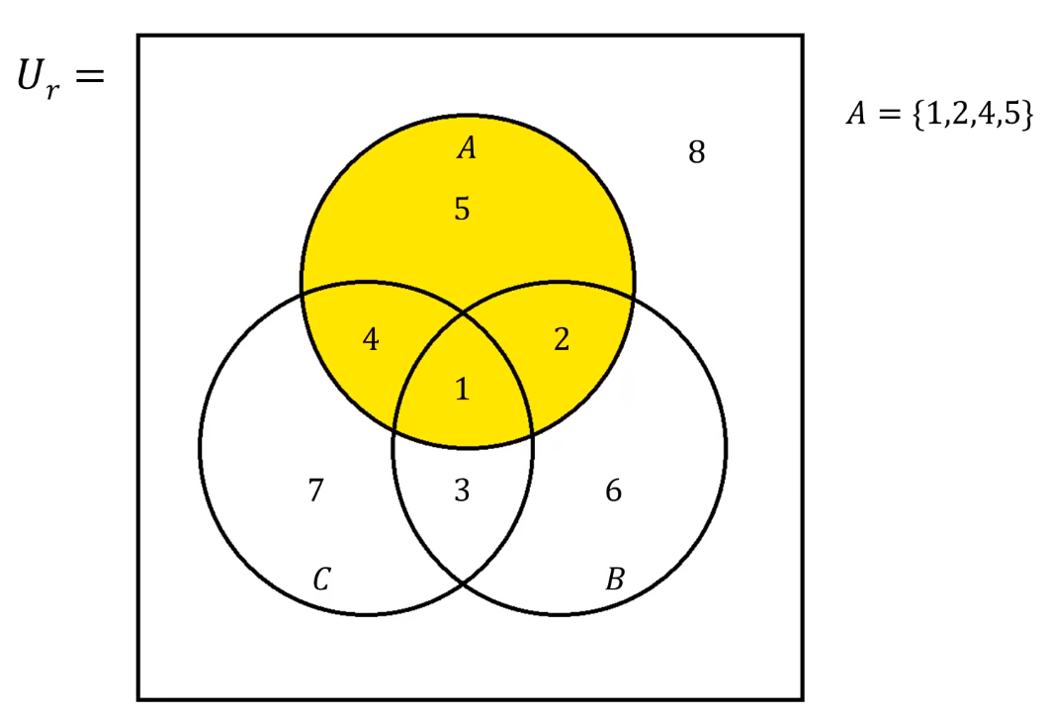
Venn Diagram Region “Map”
Example:

Slide 43
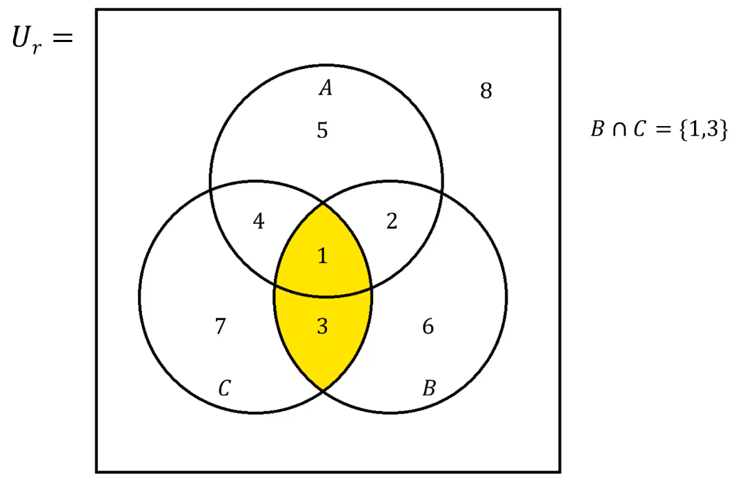
Venn Diagram Region “Map”
Example:

Slide 44
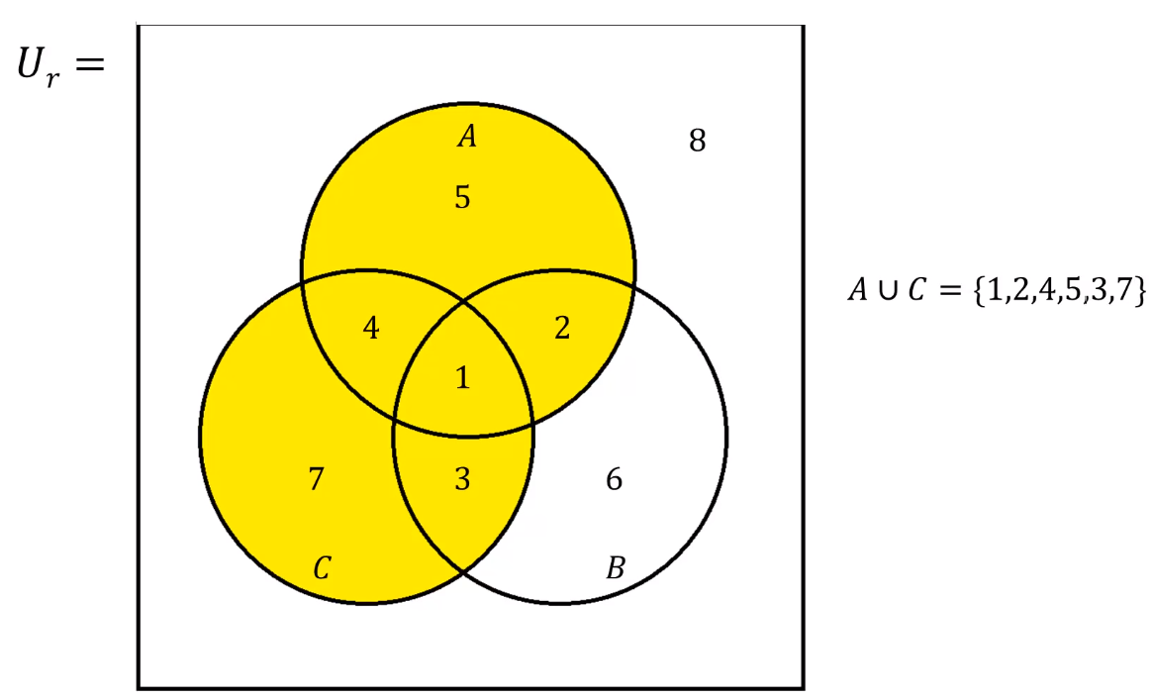
Venn Diagram Region “Map”
Example:

Slide 45
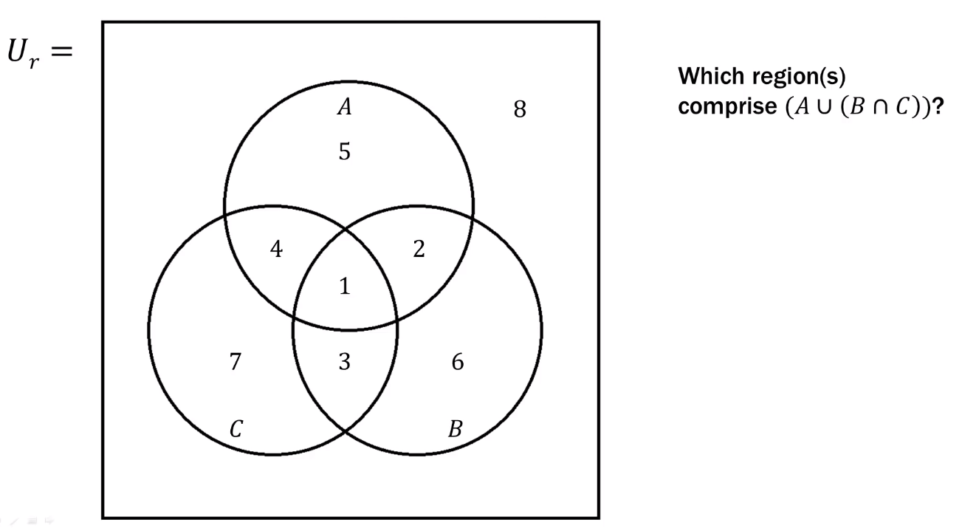
Venn Diagram Region “Map”
Question:

Slide 46
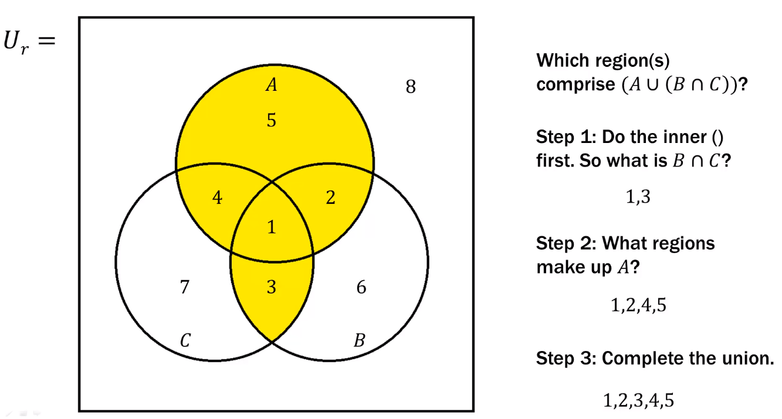
Venn Diagram Region “Map”
Solution:

Slide 47

Venn Diagram Region “Map”
Question:

Slide 48
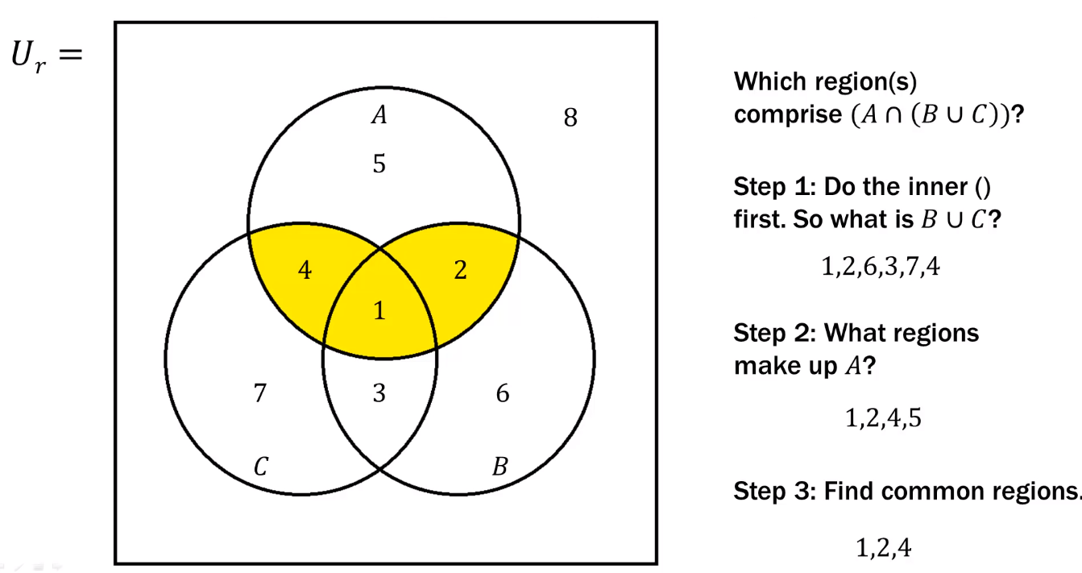
Venn Diagram Region “Map”
Solutions:

Slide 49
Venn Diagram Region - Summary
A Venn diagram can be broken down into several discrete regions.
Each set, subset, intersection, union etc. can then be written as a list of regions.
From those list you can then figure out intersections, unions, etc., whatever problem is asking you to find.
Once you have your list based answer, you can then go back and shade in the appropriate regions in the Venn diagram.

